Slide 1
Scenario
Scenario
  Imagine yourself living by all yourself , in total isolation
  What will happen?
  Will you be as careful with how you dress/ eat etc.?

Slide 2
Why do members of a social group, subculture, society tend to hold similar beliefs and act in similar ways?

Slide 3
Social Influence
Efforts by others to change our attitude, beliefs, perception, or behaviour

Slide 4
Types of Social Influence
Conformity
Compliance
Obedience

Slide 5
Definitions
Conformity: Individuals change their attitude or behavior in order to adhere to existing social norms
Compliance: Involving direct request fro one person to other
Obedience: One obeys direct orders from another to perform some action

Slide 6
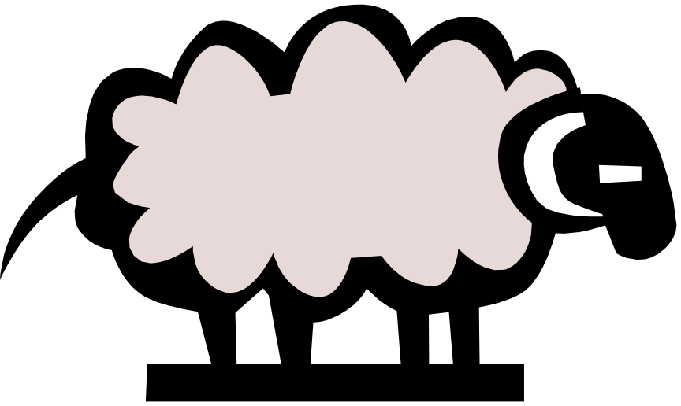
Conformity
How similar are we to sheep and lemmings?

Slide 7
Is Conformity Good or Bad?
Individuality has a certain allure
But
  Another word for individualist may be ‘deviant’ (under certain context)
  Another word for conformist is ‘team player’

Slide 8
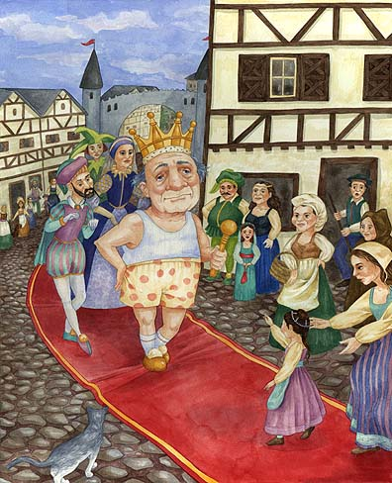
Why Conform?
Our sanity depends to some degree on the belief that everyone sees the same world that we see
If this belief is challenged, we’d rather change what we see (or what we say we see) than admit to ourselves (or others) that we see a different world

Slide 9
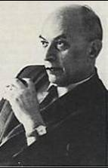
Solomon Asch:
Conformity in an
Unambiguous
Situation

Slide 10
Asch Line Judgment Experiments
Stimulus
A
B
C

Slide 11
Asch
Results:
  33% went along with the group on a majority of the trials
  25% remained completely independent
  75% conformed at least once
When tested alone (no confederates), subjects got more than 98% of the judgments correct
When tested with confederates, they only got 66% of the judgments correct

Slide 12
Why conform?
The desire to be Liked : Normative Social Influence
The Desire to be Right: Informational Influence

Slide 13
Factors Influencing Conformity
Cohesiveness: Accepting influence from those we like
Group Size: More is not always better to social Influence
Social Support
Gender
Private vs. Public Conformity

Slide 14
Compliance
Compliance is acting in accordance to a direct request from another person or group
  Occurs in many facets of life (e.g., salespeople,
  fundraisers, politicians, and anyone else who
  wants to get people to say “yes” to their requests)

Slide 15
Six Universal Influence Principles
Reciprocity – the need to return a favor, gift, or service
Consistency/ Commitment – with a prior commitment
Social Validation (Consensus) – the behavior/opinions of similar others
4) Liking – the impact of those who express liking for “targets”
Authority – the role of legitimate authority figures, expertise
6) Scarcity – the value/desire for things that are rare, less available

Slide 16
Compliance Techniques
Ingratiation
The Foot in the door
Low Ball
Bait and Switch
The Door in the face
That’s not all
Foot in the mouth
Deadline
Complaining

Slide 17
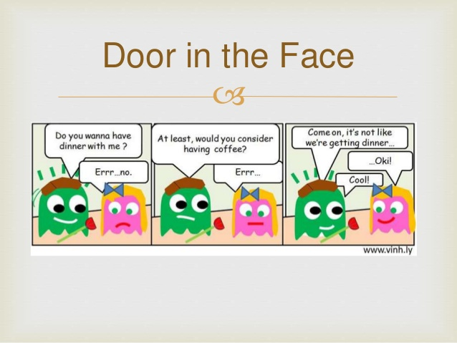

Slide 18
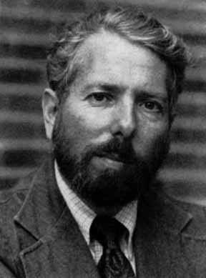
Stanley Milgram: Obedience to Authority
Participants brought into “experiment on learning through punishment”.
Participant is always the “teacher,” the confederate is always the learner.
Everytime that the learner is wrong on a word recognition task the teacher must administer a shock, with the shock increasing by 15 volts with each incorrect answer.

Slide 19
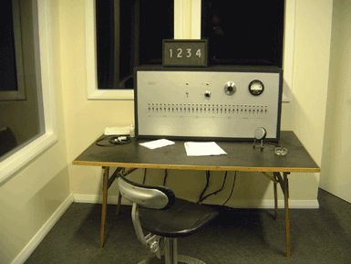
Milgram – Obedience

Slide 20
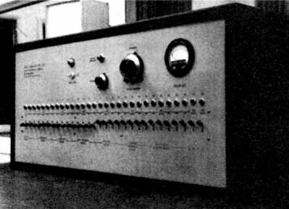
Stanley Milgram: Obedience to Authority
As the voltage increases, the “learner’s” objections become more vehement until they stop responding altogether at 345 volts.
The question becomes, when do participants absolutely refuse to continue (they have to say they won’t continue 4 consecutive times in order for the experimenter to stop the experiment).
65% of the participants went all the way to the end (450 volts).

Slide 21

Other Variables and Thoughts to Consider
Milgram manipulated a number of different variables:
  Distance between learner and teacher.
  Distance between experimenter and teacher.
  Location of the study.
  Whether the participant was the “shocker” or just an observer.
Foot in the Door/Cognitive Dissonance.
Fundamental Attribution Error.

Slide 22
Ethical Implications
I observed a mature and initially poised businessman enter the laboratory smiling and confident. Within 20 minutes he was reduced to a twitching, stuttering wreck, who was rapidly approaching nervous collapse. He constantly pulled on his ear lobe, and twisted his hands. At one point he pushed his fist into his forehead and muttered ' Oh God, let's stop it '. And yet he continued to respond to every word of the experimenter, and obeyed to the end."

